Slide 1
Creative Arts – Music
Year 9 and 10

Slide 2
What do you do?
Continue to develop instrumental/vocal and musicianship skills as a soloist and in an ensemble.
Analyse a variety of musical genres, music history and music of other cultures.
Analyse and read musical scores.
Learn about Australian music and compose and perform original music.
Collaborate with peers to compose, arrange and perform music.
Record original music using a variety of digital audio software using the school’s DAW.

Slide 3
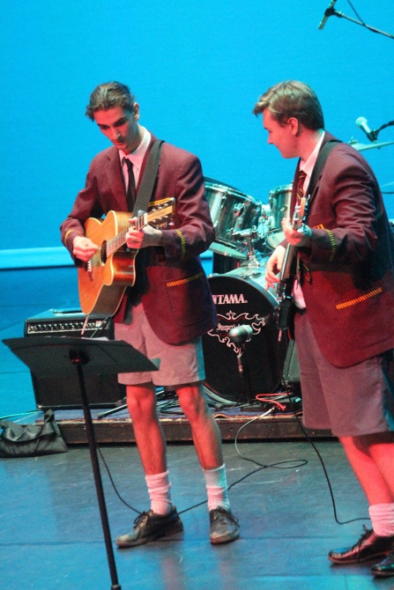
What you need?
Pre-existing skills and knowledge on an instrument or voice.
A willingness to perform in front of peers and further develop solo and ensemble skills.
Enthusiasm, creativity and an open mind.
Critical thinking and inquiry skills.
Self-reflection on their own strengths, capabilities and opportunities for growth and progress.

Slide 4
Find out more…
Please feel free to contact Mr Mike O’Brien, Head of Creative Arts, at mobrien@dominic.tas.edu.au

